Slide 1
Advancements in Color Detection Technologies and the Development of Invisibility Cloaks
P. Swetha Sri (192225029)
K.B Thanuja Sree (192225044)

Slide 2
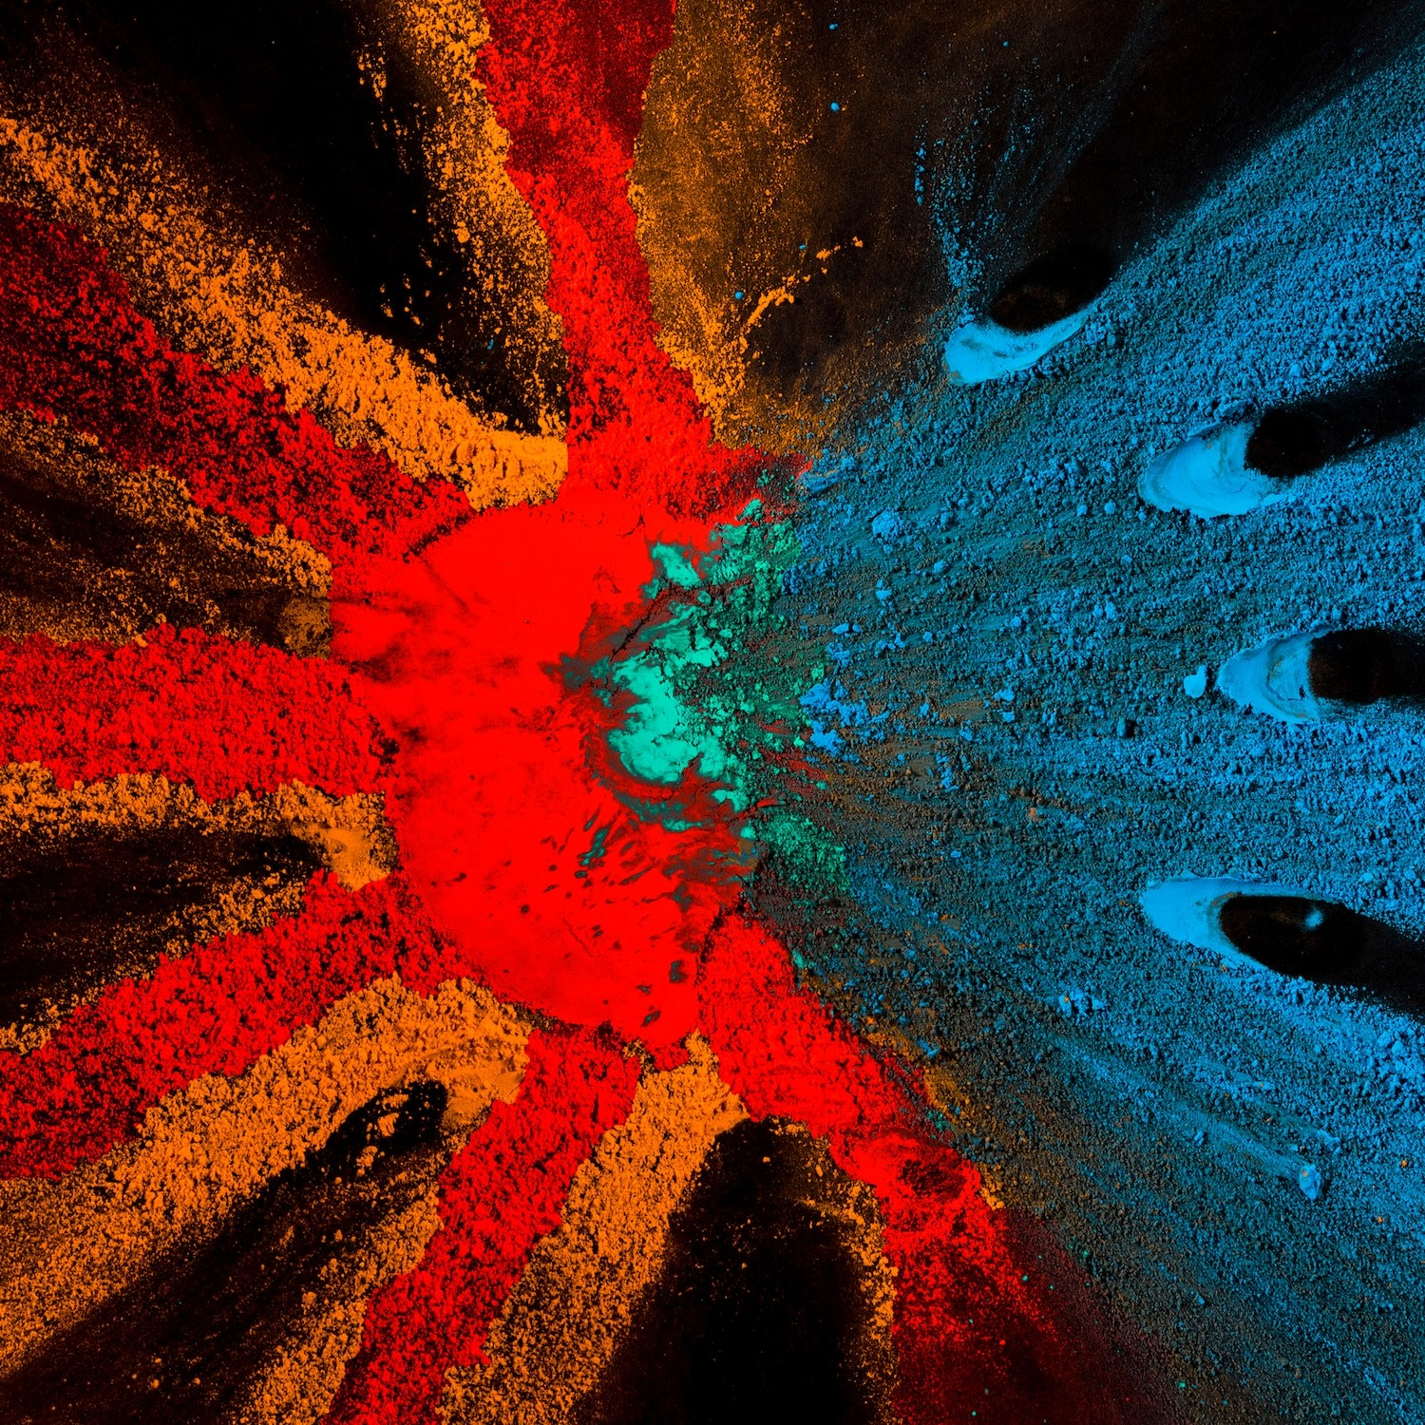
Introduction to Color Detection
This presentation explores advancements in color detection technologies and their role in the development of invisibility cloaks. We will examine the scientific principles behind these innovations and their potential applications across various fields.

Slide 3

Understanding Color Detection
Color detection involves identifying and analyzing wavelengths of light. Recent advancements in spectroscopy and machine learning have improved accuracy and efficiency, allowing for better real-time analysis in various applications from art restoration to medical diagnostics.

Slide 4
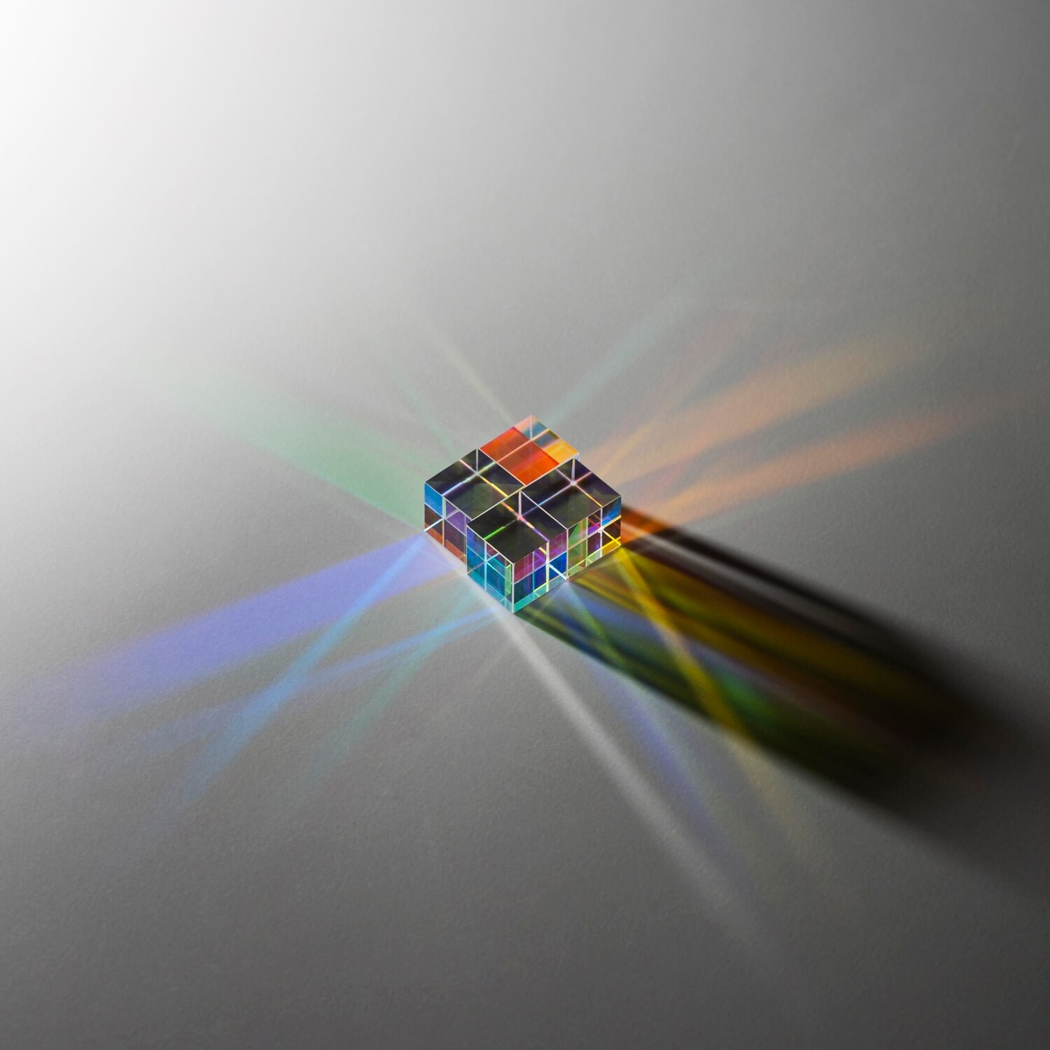
Technologies Behind Color Detection
Key technologies include RGB sensors, spectrometers, and camera systems that capture and process color data. These devices leverage algorithms to interpret color information, enabling applications in fields such as agriculture, manufacturing, and environmental monitoring.

Slide 5

Introduction to Invisibility Cloaks
Invisibility cloaks are designed to manipulate light waves around an object, rendering it invisible. This technology builds on principles of metamaterials and optical camouflage, which have gained significant attention in both scientific research and popular culture.

Slide 6
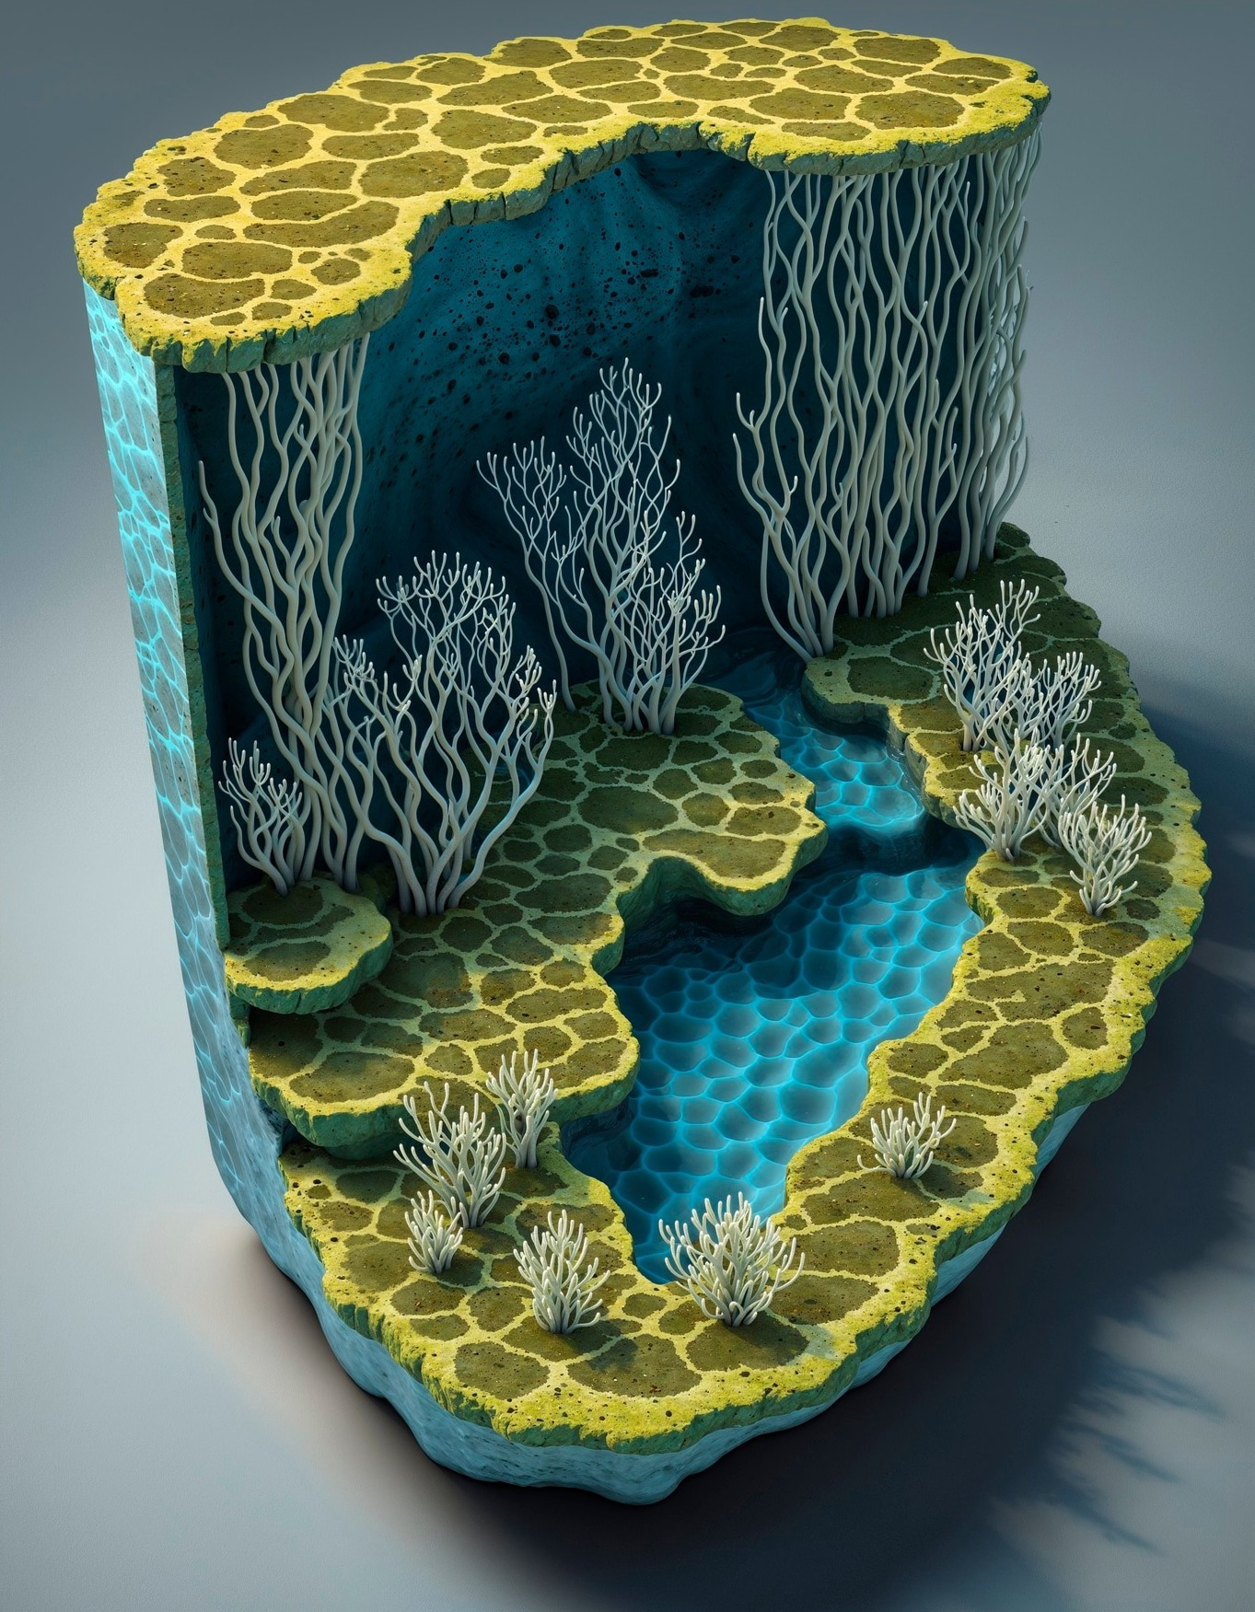
Metamaterials and Their Role
Metamaterials are engineered to have properties not found in nature, allowing for the bending and manipulation of light. This capability is crucial for developing effective invisibility cloaks, which can potentially revolutionize military and privacy applications.

Slide 7

Applications of Invisibility Technology
The potential applications of invisibility technology extend beyond military use. They include stealth technology, privacy protection, and even medical imaging. These advancements could lead to significant improvements in security and personal privacy.

Slide 8

Current Challenges and Limitations
Despite advancements, challenges remain in the field of color detection and invisibility technology. Issues such as cost, scalability, and environmental factors pose significant hurdles to widespread adoption and practical implementation.

Slide 9
Program:
import cv2
import time
import numpy as np
VideoWriter_fourcc(*'XVID’)
out = cv2.VideoWriter('output.avi', fourcc, 20.0, (640, 480))
cap = cv2.VideoCapture(0)
time.sleep(3)
count = 0
background = 0
for i in range(60):
ret, background = cap.read()
background = np.flip(background, axis=1)
while (cap.isOpened()):
ret, img = cap.read()
if not ret:
break count += 1 img = np.flip(img, axis=1)
hsv = cv2.cvtColor(img, cv2.COLOR_BGR2HSV)
lower_red = np.array([0, 120, 50])
upper_red = np.array([10, 255,255])

Slide 10
mask1 = cv2.inRange(hsv, lower_red, upper_red)
lower_red = np.array([170, 120, 70])
upper_red = np.array([180, 255, 255])
mask2 = cv2.inRange(hsv, lower_red, upper_red)
mask1 = mask1 + mask2
mask1 = cv2.morphologyEx(mask1, cv2.MORPH_OPEN, np.ones((3, 3), np.uint8))
mask1 = cv2.morphologyEx(mask1,
cv2.MORPH_DILATE, np.ones((3, 3), np.uint8))
mask2 = cv2.bitwise_not(mask1)
res1 = cv2.bitwise_and(img, img, mask=mask2)
res2 = cv2.bitwise_and(background, background, mask=mask1)
finalOutput = cv2.addWeighted(res1, 1, res2, 1, 0)
out.write(finalOutput)
cv2.imshow("magic", finalOutput)
cv2.waitKey(1)
cap.release()
out.release()cv2.destroyAllWindows()

Slide 11

Output
Once you run the code wait for a few seconds, let the webcam capture the background image then you can come inside the frame with your magical Cloak and be invisible

Slide 12

Conclusion: Future Prospects
The future of color detection and invisibility technology is promising. As research continues and technological innovations emerge, we may see breakthroughs that enhance our understanding and capabilities, leading to transformative applications in various sectors.

Slide 13
Thanks!

